Slide 1
SMARTPARKIQ
TEAM 8:
Janani Karthikeyan - System Architect & Technical Strategist
Mansi Raturi - UI/UX Designer & Research Lead
Suyog Baral - Business Strategist & Market Analyst

Slide 2
PRODUCT DESCRIPTION
01

Slide 3
SMARTPARKIQ
SmartParkIQ is an AI-powered parking concierge that combines real-time pricing intelligence with integrated micro-insurance protection.
Our unique value proposition: "Never overpay, never worry about parking damage”

Slide 4
PRODUCT DESCRIPTION
AI-powered parking concierge that solves parking anxiety through comprehensive protection and intelligence.
Features:
Dynamic Pricing Intelligence - Prediction of pricing surge and real-time cost comparison across all nearby options
Integrated Vehicle Insurance- One-click protection ($0.50-$3.00) against parking damage, theft and vandalism
Smart Recommendations - Personalized suggestions based on user preferences
Core Value Proposition: "Never overpay, never worry about parking damage"
Target Users: Urban professionals, commuters, and city visitors who value time, money, and peace of mind.

Slide 5
BACKGROUND
PARKING CRISIS
CURRENT SOLUTIONS
TECHNOLOGY FOUNDATION FOR OUR SOLUTION
Urban Reality: 17 hours wasted annually for parking search
Financial Impact: $345 per driver lost in time, fuel, and stress costs
Behavioral Change: 73% of drivers avoid destinations due to parking uncertainty
Hidden Costs: $13 billion towing/damage industry with no user protection
Existing Apps: Focus only on booking efficiency, ignore user protection
Technology Gap: No surge pricing predictions or cost optimization alerts
User Dissatisfaction: 45% monthly churn rate, poor ratings
Smart Parking Evolution: From mechanical systems (1905) to IoT sensors (2000s) to AI/ML prediction (2020s)
Mobile Payment Infrastructure: Proven contactless transaction capabilities
Insurance Technology: Micro-policy platforms enabling instant coverage activation

Slide 6
02
BUSINESS MODEL

Slide 7
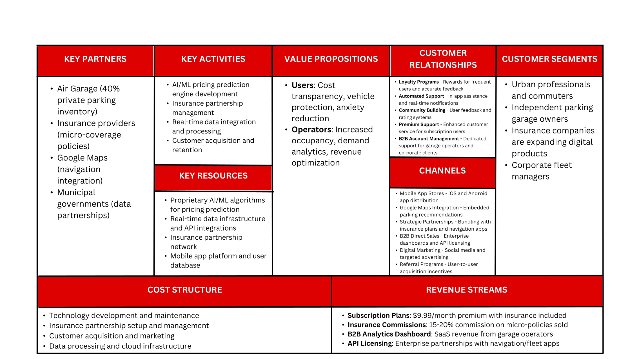
LEAN CANVAS BUSINESS MODEL
BACKGROUND
PARKING CRISIS
CURRENT SOLUTIONS
TECHNOLOGY FOUNDATION FOR OUR SOLUTION
Urban Reality: 17 hours wasted annually for parking search
Financial Impact: $345 per driver lost in time, fuel, and stress costs
Behavioral Change: 73% of drivers avoid destinations due to parking uncertainty
Hidden Costs: $13 billion towing/damage industry with no user protection
Existing Apps: Focus only on booking efficiency, ignore user protection
Technology Gap: No surge pricing predictions or cost optimization alerts
User Dissatisfaction: 45% monthly churn rate, poor ratings
Smart Parking Evolution: From mechanical systems (1905) to IoT sensors (2000s) to AI/ML prediction (2020s)
Mobile Payment Infrastructure: Proven contactless transaction capabilities
Insurance Technology: Micro-policy platforms enabling instant coverage activation

Slide 8
03
MARKET RESEARCH

Slide 9
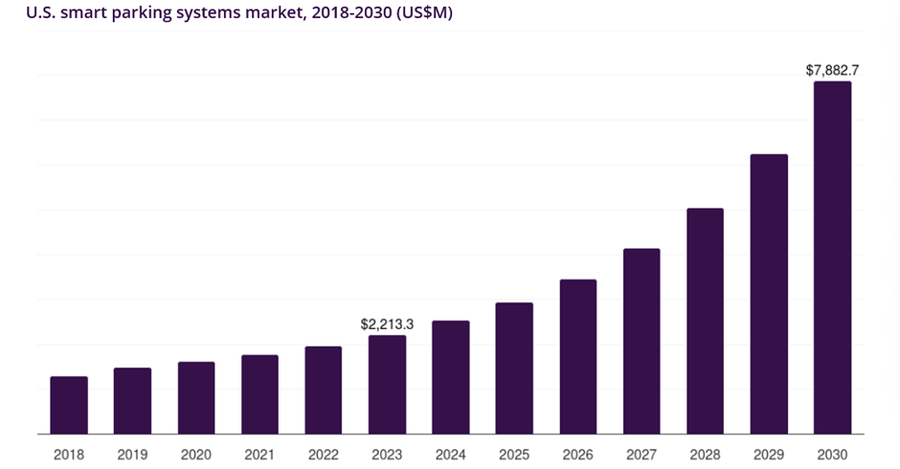
MARKET RESEARCH
Market Size & Opportunity:
Global parking management: $4.8B (2024) → $9.3B (2030)
U.S. with the fastest growing regional market, projected to reach USD 7,882.7 million by 2030 with CAGR of 19.9%
Survey shows 67% of drivers willing to pay $10-15/month for parking protection
Source: GrandViewResearch

Slide 10
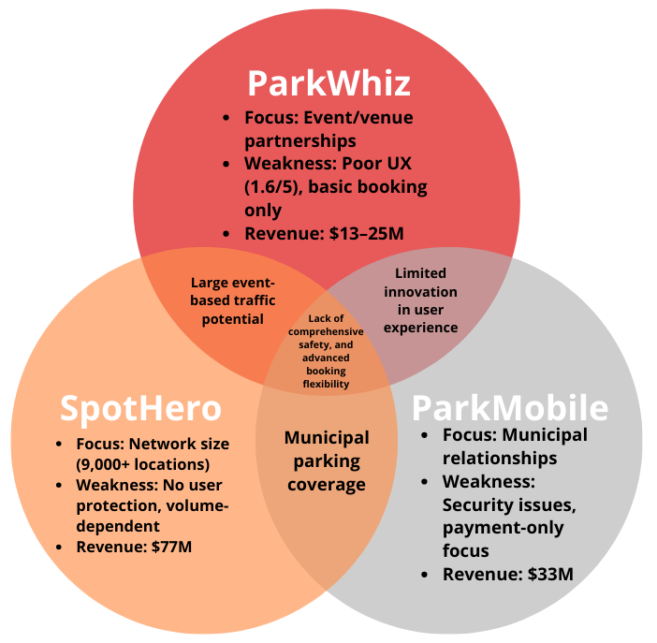
COMPETITION
COMPETITORS | sParQ | SpotHero | ParkWhiz | ParkMobile
INVENTORY FLEXIBILITY | ✅ | ❌ | ❌ | ✅
UI/UX DESIGN | ✅ | ✅ | ❌ | ✅
USER PROTECTION | ✅ | ❌ | ❌ | ❌
METER PAYMENTS | ✅ | ❌ | ❌ | ✅
PROFITABILITY
FEASIBILITY

Slide 11
Market Research - Validation & Customer Evidence
User Research Validation (50+ drivers surveyed):
84% would switch apps for integrated insurance protection
89% want surge pricing alerts before price increases
78% prefer parking integrated into navigation vs. separate apps
73% avoid destinations specifically due to parking anxiety
Competitive Vulnerabilities We Exploit:
SpotHero's Gap: Strong operator tools, weak user protection
Our Advantage: User-focused pricing alerts and insurance integration
ParkWhiz's Failure: Poor user satisfaction and experience
Our Advantage: Anxiety-reducing design and comprehensive protection
ParkMobile's Risk: Major data breach damaged user trust
Our Advantage: Security-first approach with insurance-grade protection
Total Addressable Market: $2.1B (US urban parking anxiety market)

Slide 12
PROTOTYPE STRUCTURE
04

Slide 13
PROTOTYPE
10+ Interactive Screens: Splash, login, map view, booking, payment, confirmation
Full User Journey: Search → Compare → Protect → Book → Pay → Confirm
Live Figma Demo: Clickable prototype with realistic interactions
Key Interface Innovations:
Color-coded pricing pins (green=cheap, red=expensive)
Real-time availability with exact spot counts
Integrated insurance options within each parking card
Surge Pricing Alerts:
Orange warning banners: "Event detected - prices may increase 40% after 6 PM"
Proactive cost-saving notifications before price spikes
Seamless Insurance Integration:
Shield icons with clear protection pricing (+$1.50, +$2.50)
One-tap coverage activation within booking flow
Trust-building elements throughout payment process

Slide 14
VALIDATION RESULTS
05

Slide 15
VALIDATION RESULTS
User Testing Results (18 participants completed):
Hypothesis Validation:
H1: 89% of users successfully booked parking in <3 minutes (Target: 80%)
H2: 94% easily understood fee comparison and insurance options (Target: 80%)
H3: Payment process rated 4.3/5 for ease of use (Target: 4/5)
H4: Map navigation rated 4.6/5 for clarity (Target: 4/5)
Critical User Insights:
Insurance Acceptance: 78% opted for vehicle protection during testing "Finally, a parking app that actually protects my car" - Tester #12
Surge Alert Value: 92% found price increase warnings "extremely useful" "This would have saved me $30 last week at the concert" - Tester #7
UX Excellence: Average task completion in 2:14 minutes "Much clearer than SpotHero or ParkWhiz" - Tester #15
Market Readiness:
85% said they would download SmartParkIQ immediately
91% would recommend to friends and colleagues
Average likelihood to use: 4.4/5
Iteration Complete: Ready for beta launch based on validation success.

Slide 16
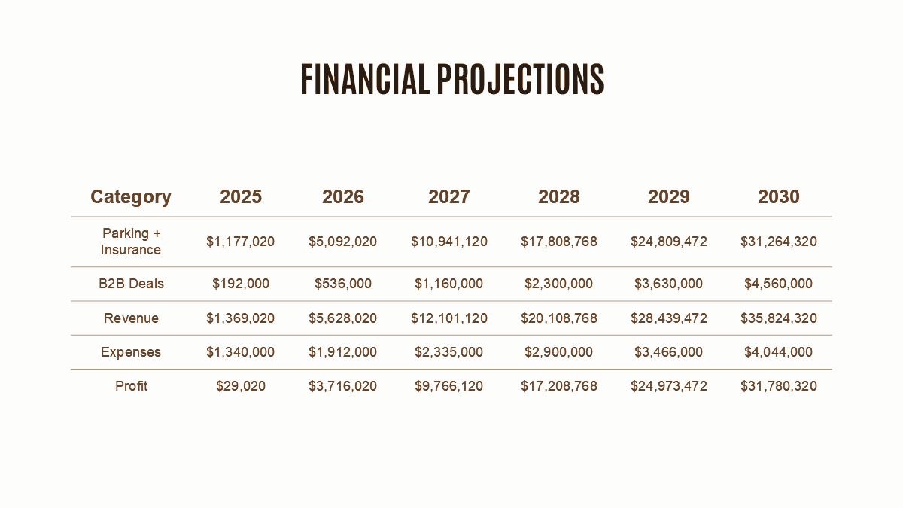
VALIDATION RESULTS
User Testing Results (18 participants completed):
Hypothesis Validation:
H1: 89% of users successfully booked parking in <3 minutes (Target: 80%)
H2: 94% easily understood fee comparison and insurance options (Target: 80%)
H3: Payment process rated 4.3/5 for ease of use (Target: 4/5)
H4: Map navigation rated 4.6/5 for clarity (Target: 4/5)
Critical User Insights:
Insurance Acceptance: 78% opted for vehicle protection during testing "Finally, a parking app that actually protects my car" - Tester #12
Surge Alert Value: 92% found price increase warnings "extremely useful" "This would have saved me $30 last week at the concert" - Tester #7
UX Excellence: Average task completion in 2:14 minutes "Much clearer than SpotHero or ParkWhiz" - Tester #15
Market Readiness:
85% said they would download SmartParkIQ immediately
91% would recommend to friends and colleagues
Average likelihood to use: 4.4/5
Iteration Complete: Ready for beta launch based on validation success.

Slide 17
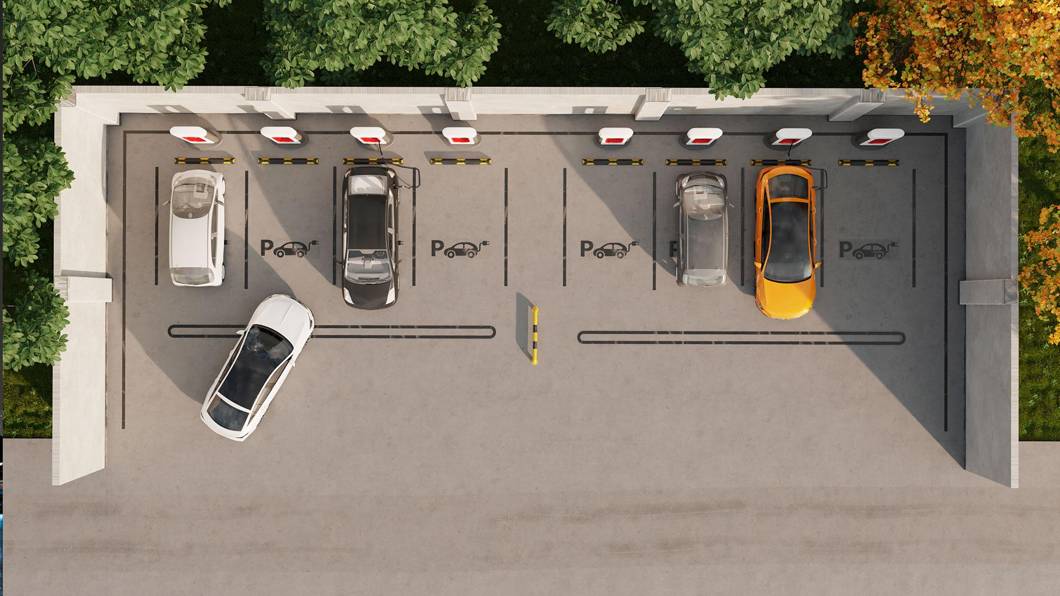
Questions

